Slide 1
Secure Coding Techniques
Unit - IV

Slide 2
TECHNIQUES FOR PROTECTING AGAINST DOS ATTACKS
Firewalls and Router Security
2. Load Balancing
3. Intrusion Prevention Systems (IPS
4. Antivirus and Anti-Trojan Software
5. Honeypots
6. Traffic Monitoring and Anomaly Detection
7. Rate Limiting and Throttling
8. Content Delivery Networks (CDNs)
9. Secure Coding and Input Validation
10. Redundancy and Backup Systems

Slide 3
APPLICATION FAILURE ATTACKS
Invalid Input
Buffer Overflow
Null Pointer Dereference
Resource Exhaustion
Race Conditions
Improper Error Handling

Slide 4
CPU Starvation Attacks
A CPU starvation attack occurs when a malicious process monopolizes CPU resources, preventing other legitimate processes from executing in a timely manner. The goal is to starve other applications or services by consuming excessive CPU cycles, leading to performance degradation or system unresponsiveness.
Causes of CPU Starvation
High-priority looped processes: A program is intentionally set to the highest priority and runs an infinite loop, consuming CPU without yielding.
Thread or process flooding: Launching a large number of concurrent threads or processes that constantly request CPU time.
Improper scheduling settings: Exploiting flaws in the OS or scheduler that allow some processes to unfairly dominate CPU access.
Resource Locking or Blocking Calls: Keeping system resources locked for long periods causes other processes to be queued, increasing wait time.

Slide 5
INSECURE CODING PRACTICES IN PYTHON/JAVA TECHNOLOGY
1. Hardcoding Sensitive Information:
Storing sensitive data like passwords, API keys, or database credentials directly in the code.
Example (Python): password = "admin123"
Example (Java): String dbPassword = "secret";
Risk: Attackers who gain access to the codebase (even temporarily) can extract credentials and misuse them.
2. Improper Input Validation:
Failing to check or sanitize user inputs can lead to attacks such as SQL Injection, Cross-Site Scripting (XSS), or code injection.
Example (Python - SQL Injection): query = "SELECT * FROM users WHERE username = '" + user_input + "';"
Example (Java - SQL Injection):
String query = "SELECT * FROM users WHERE username = '" + input + "'";
Risk: Attackers can craft malicious inputs to gain unauthorized access or manipulate the system.

Slide 6
3. Use of eval() or exec() Functions:
Using these functions can execute arbitrary code, which becomes dangerous if it includes user inputs.
Example (Python): eval("print(" + user_input + ")")
Risk: Allows attackers to run malicious code on the server.
4. Lack of Error Handling:
Failing to handle errors securely can expose sensitive information like stack traces, file paths, or configurations.
Example (Python):
except Exception as e:
print(e) # Reveals internal error details
Risk: Leaks internal system details that help attackers map vulnerabilities.

Slide 7
5. Improper Use of Cryptography:
Using weak or outdated algorithms, or writing custom encryption instead of using secure libraries.
Example (Python):
import hashlib
hashlib.md5(password.encode()) # MD5 is outdated
Risk: Easier for attackers to break encryption or hashes.
6. Insufficient Authorization Checks:
Assuming that users are authorized without verifying roles or access levels.
Risk: Users may access restricted features or data.

Slide 8
7. Logging Sensitive Data:
Logging full user input or credentials for debugging purposes.
Example: print("Login attempt: " + username + " with password: " + password)
Risk: Leads to sensitive data exposure in logs.
8. Not Using HTTPS or Secure Communication:
Sending data like passwords or tokens over unencrypted channels.
Risk: Enables eavesdropping or man-in-the-middle (MitM) attacks.

Slide 9
ARP SPOOFING
ARP (Address Resolution Protocol) is used to map IP addresses to MAC addresses. In an ARP Spoofing attack, the attacker sends forged ARP messages to the local network, associating their MAC address with the IP address of a legitimate device, usually the gateway or another critical network device. This allows the attacker to intercept, modify, or completely stop the data intended for the target device.

Slide 10
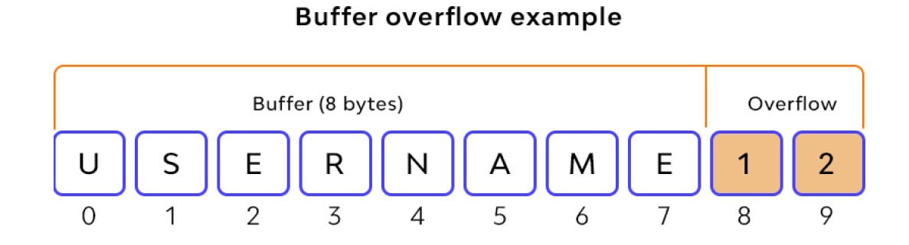
Buffer Overrun- Stack Overrun, Heap Overrun:
A buffer overrun occurs when a program writes more data into a buffer than it can hold, overwriting adjacent memory and potentially corrupting the system or leading to security vulnerabilities.

Slide 11
Types:
1. Stack Overflow:
Example: #include <stdio.h>
void overflow() {
char buffer[10];
printf("Enter a string: ");
gets(buffer); // Dangerous! Doesn't check the size of input
printf("You entered: %s\n", buffer);
}
int main() {
overflow();
return 0;
}

Slide 12
Types:
2. Heap Overflow:
Example: #include <stdio.h>
#include <stdlib.h>
#include <string.h>
int main() {
char *buffer = (char*) malloc(10 * sizeof(char)); // Allocate 10 bytes
strcpy(buffer, "This string is too long!"); // Writing beyond allocated memory
printf("Buffer: %s\n", buffer);
free(buffer);
return 0;
}

Slide 13
ARRAY INDEXING ERRORS:
Example:
const weapons = [ { name: 'stick', power: 5 }, { name: 'dagger', power: 30 }, { name: 'claw hammer', power: 50 }, { name: 'sword', power: 100 } ];
The valid indices for this array are 0 to 3 because it has 4 elements. If you try to access weapons[4], it doesn’t exist, so JavaScript returns undefined. Attempting to read .name from undefined causes an error.

Slide 14
FORMATSTRING BUGS:
A format string bug occurs when user-supplied input is used as a format string in functions like printf(), fprintf(), or sprintf() without proper validation.
This can allow an attacker to:
Read arbitrary memory
Crash the program
Execute arbitrary code
In C/C++, functions like printf() use format specifiers to format output, such as: printf("Value: %d", number);
Here, %d is a format specifier for integers.

Slide 15
Example:
When user input is directly used as the format string, like this:
char input[100];
scanf("%s", input);
printf(input); // DANGEROUS!
If a malicious user enters something like %x %x %x %x, it causes the program to treat the input as format instructions, leading to memory leakage or corruption.

